Slide 1
Chapter 10 Database Management

Slide 2
Chapter 10 Objectives
Define the term, database
Differentiate between a file processing system approach and the database approach
Identify the qualities
of valuable information
Discuss the functions
common to most DBMSs
Explain why data is important
to an organization
Describe characteristics of
relational, object-oriented, and multidimensional databases
Discuss the terms character,
field, record, and file
Explain how to interact with Web databases
Identify file maintenance techniques
Discuss the responsibilities of
database analysts and administrators
Next

Slide 3
Data and Information
What is a database?
Collection of data
organized so
you can access,
retrieve, and
use it
Database software
allows you to
Database software
also called database
management system
(DBMS)
Create
database
Create
forms
and
reports
Add,
change,
and delete
data
Sort
and
retrieve
data
p. 514
Next

Slide 4
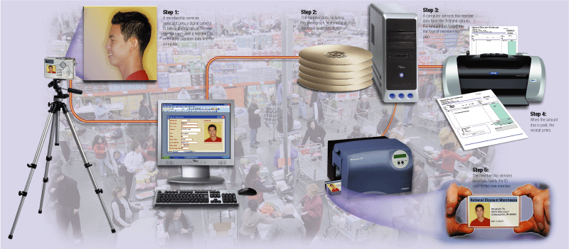
Data and Information
How are data and information related?
Data is raw facts
Information is data that is organized and meaningful
Computers process data into information
p. 514 - 515 Fig. 10-1
Next

Slide 5
Data and Information
What is data integrity?
Garbage in
  Degree to which data is correct
    Garbage in, garbage out (GIGO)—computer phrase that means you cannot create correct information from incorrect data
Garbage out
Data integrity
is lost
p. 516
Next

Slide 6
Data and Information
What are the qualities of valuable information?
Accurate
Verifiable
Timely
Organized
Accessible
Useful
Cost-effective
p. 516 - 517
Next

Slide 7
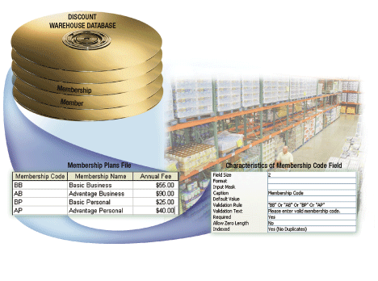
The Hierarchy of Data
What is a hierarchy?
  Database contains files, file contains records, record contains fields, field contains characters
p. 517 Fig. 10-2
Next

Slide 8

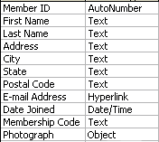
The Hierarchy of Data
What is a field?
  Combination of one or more characters
  Smallest unit of data user accesses
    Field name uniquely identifies each field
    Field size defines the maximum number of characters a field can contain
    Data type specifies kind of data field contains
p. 518 Fig. 10-3
Next

Slide 9
The Hierarchy of Data
What are common data types?
Text
(also called alphanumeric)—letters, numbers, or special characters
Numeric
numbers
only
AutoNumber
unique number automatically assigned to each new record
Currency
dollar and cent amounts or numbers containing decimal values
Date
month, day, year, and sometimes time
Memo
lengthy text entries
Object
(also called BLOB for binary large object)—photograph, audio, video, or document created in other application such as word processing or spreadsheet
Yes/No
(also called Boolean)—only the values Yes or No (or True or False)
Hyperlink
Web address that links to document or Web page
p. 518
Next

Slide 10
The Hierarchy of Data
What is a record?
Group of
related fields
Key field, or primary key,
uniquely identifies each record
p. 519
Next

Slide 11
The Hierarchy of Data
What is a data file?
  Collection of related records stored on disk
Member ID
First Name
Last Name
Address
City
State
2295
Milton
Brewer
54 Lucy Court
Shelbyville
IN
2928
Shannon
Murray
33099 Clark Street
Montgomery
AL
3876
Louella
Drake
33 Timmons Place
Cincinnati
OH
3928
Adelbert
Ruiz
99 Tenth Street
Carmel
IN
4872
Elena
Gupta
2 East Penn Drive
Pittsboro
IN
records
key field
fields
p. 518 – 519 Fig. 10-3
Next

Slide 12
Maintaining Data
What is file maintenance?
  Procedures that keep data current
    Adding records
    Changing records
    Deleting records
p. 520
Next

Slide 13
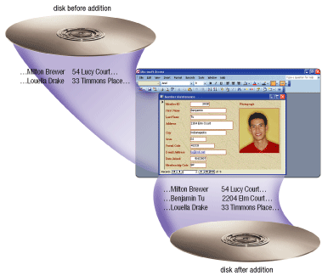
Maintaining Data
Why do you add records?
  Add new record when you obtain new data
p. 520 Fig. 10-5
Next

Slide 14
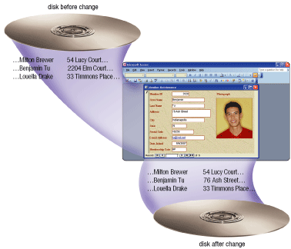
Maintaining Data
Why do you change records?
  Correct inaccurate data
  Update old data
p. 521 Fig. 10-6
Next

Slide 15
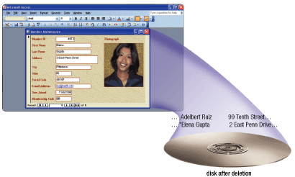
Maintaining Data
Why do you delete records?
  When record no longer is needed
  Some programs remove record immediately, others flag record
p. 522 Fig. 10-7
Next

Slide 16
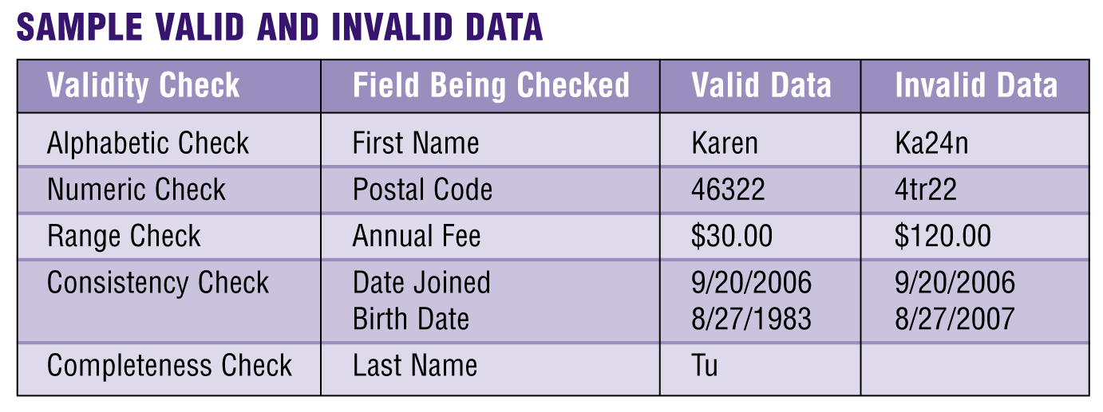
Maintaining Data
What is validation?
  Process of comparing data with a set of rules to find out if data is correct
  Reduce data entry errors and enhance data integrity before program writes data on disk
p. 522 - 523 Fig. 10-8
Next

Slide 17
Maintaining Data
What are the types of validity checks?
    Check Digit
    number(s) or character(s) appended to or inserted into a primary key value to confirm accuracy of primary key value
    Alphabetic/
    Numeric Check ensures correct type of data entered
    Completeness Check
    verifies that a required field contains data
    Range Check determines whether number is within specified range
    Consistency Check
    tests for logical relationship between two or more fields
Click to view Web
Link, click Chapter 10, Click
Web Link from left
navigation, then click
Check Digits below Chapter 10
p. 523
Next

Slide 18
File Processing Versus Databases
What is a file processing system?
Each department or area within organization has own set of files
Records in one file may not relate to records in any other file
May have weaknesses
Data redundancy—same fields stored in multiple files
Isolated data—data stored in separate files so it is difficult to access
p. 524
Next

Slide 19
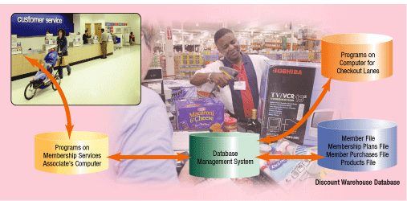
File Processing Versus Databases
What is the database approach?
  Many programs and users can share data in database
  Secures data so only authorized users can access certain data
p. 524 Fig. 10-9
Next

Slide 20
File Processing Versus Databases
What are the strengths of the database approach?
Reduced data redundancy
Improved data integrity
Shared
data
Easier
access
Reduced development time
p. 525
Next

Slide 21
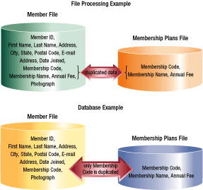
File Processing Versus Databases
How do a database application and a file processing application differ in the way they store data?
p. 525 Fig. 10-10
Next

Slide 22
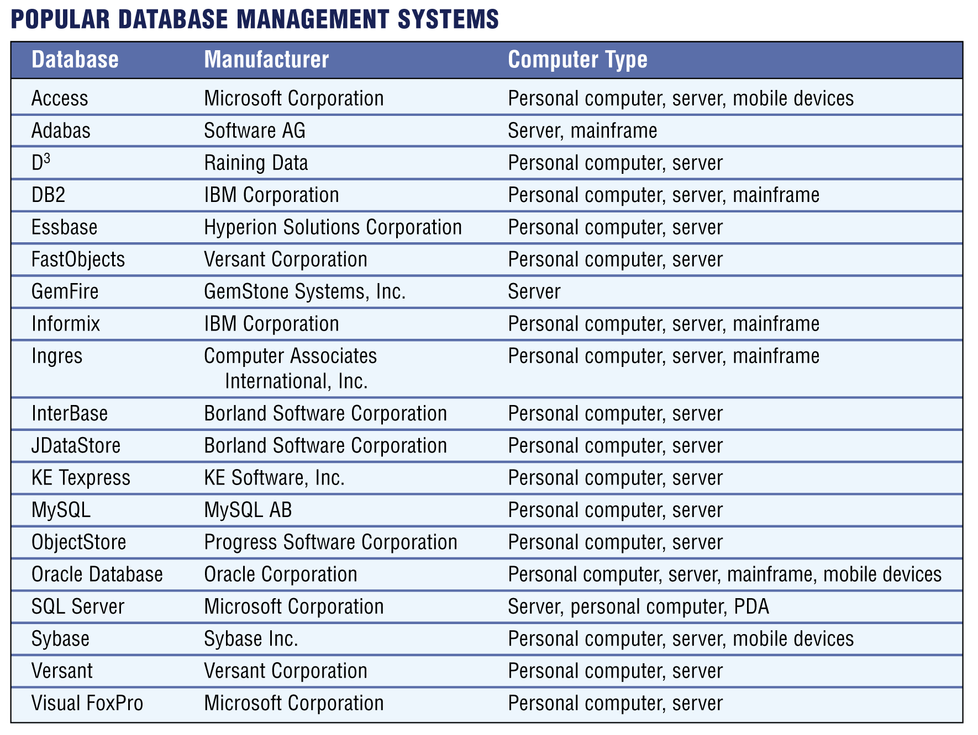
Database Management Systems
What are popular database management systems (DBMSs)?
Click to view Web
Link, click Chapter 10,
Click Web Link from left
navigation, then click
Database Management
System below Chapter 10
p. 526 Fig. 10-11
Next

Slide 23
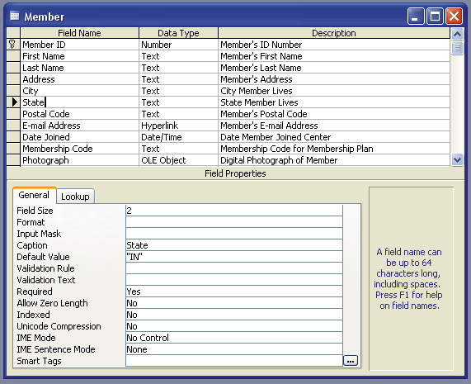
Database Management Systems
What is a data dictionary?
  Contains data about each file in database and each field within those files
p. 527 Fig. 10-12
Next

Slide 24
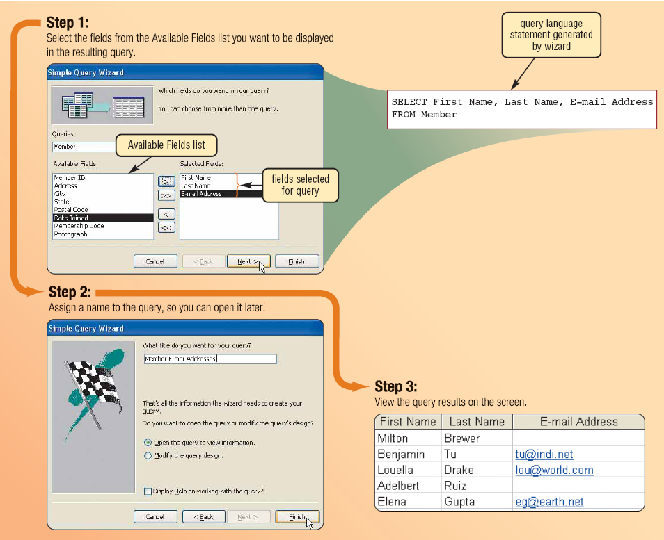
Database Management Systems
What is a query?
  Request for specific data from a database
  Query language consists of simple, English-like statements that allow users to specify data to display, print, or store
Click to view Web
Link, click Chapter 10, Click
Web Link from left
navigation, then click
Query
below Chapter 10
p. 528 Fig. 10-13
Next

Slide 25

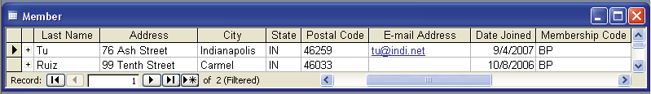
Database Management Systems
What is a query by example (QBE)?
  Program retrieves records that match criteria entered in form fields
  Has a graphical user interface that assists users with retrieving data
Query by example screen
Query results
criteria
p. 528 - 529 Fig. 10-14
Next

Slide 26
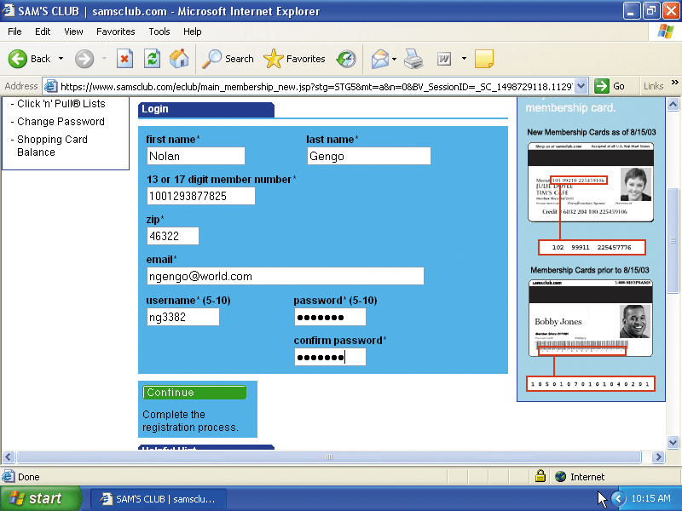
Database Management Systems
What is a form?
  Window on screen that provides areas for entering or changing data in database
  Used to retrieve and maintain data in a database
  Form that sends data across network or Internet is called e-form, short for electronic form
p. 530 Fig. 10-15
Next

Slide 27
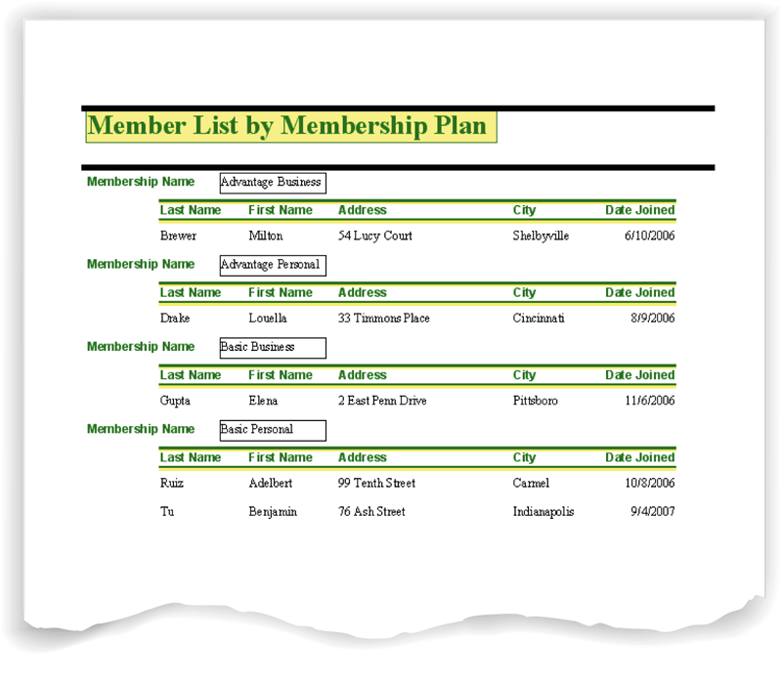
Database Management Systems
What is a report generator?
  Allows user to design a report on screen, retrieve data into report design, then display or print reports
  Also called report writer
p. 530 Fig. 10-16
Next

Slide 28
Database Management Systems
What is data security?
Access privileges
define activities that specific user or group of users can perform
DBMS provides means to ensure only authorized users can access data
Read-only privileges -
user can view data, but cannot change it
Full-update privileges -user can view and change data
p. 530
Next

Slide 29
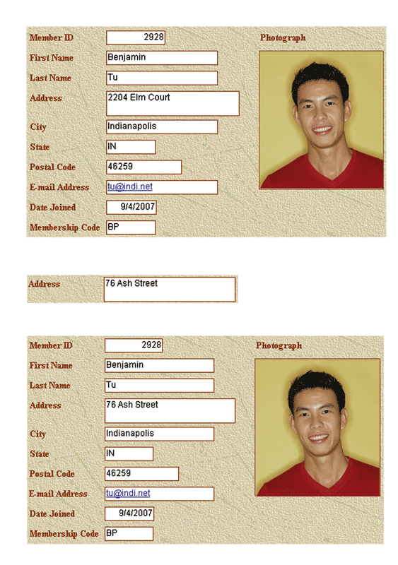
Database Management Systems
before image
What are backup and log?
  Backup is a copy of the entire database
  Log is a listing of activities that change database contents
    DBMS places three items in log: before image, actual change, and after image
change
after image
p. 531 Fig. 10-17
Next

Slide 30
Database Management Systems
What is a recovery utility?
Uses logs and/or backups to restore database when it is damaged or destroyed
Rollforward— DBMS uses log to re-enter changes made to data-base since last save or backup
  Also called forward
  recovery
Rollback— DBMS uses log to undo any changes made to database during a certain period of time
  Also called backward
  recovery
Click to view Web
Link, click Chapter 10, Click
Web Link from left
navigation, then click
Continuous Backup
below Chapter 10
p. 532
Next

Slide 31
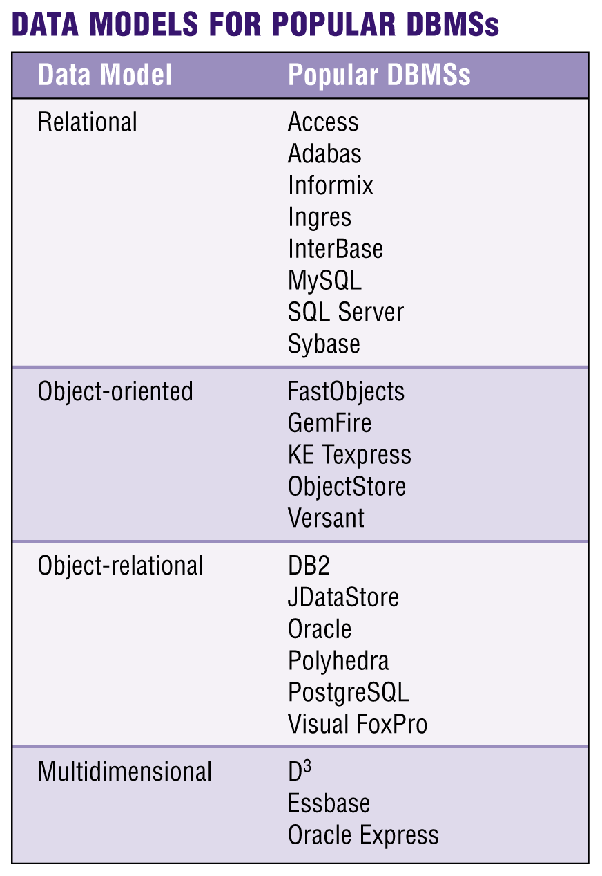
Relational, Object-Oriented, and Multidimensional Databases
What is a data model?
  Rules and standards that define how database
  organizes data
  Defines how users view organization of data
  Four popular data models
    Relational
    Object-oriented
    Object-relational
    Multidimensional
p. 532 Fig. 10-18
Next

Slide 32
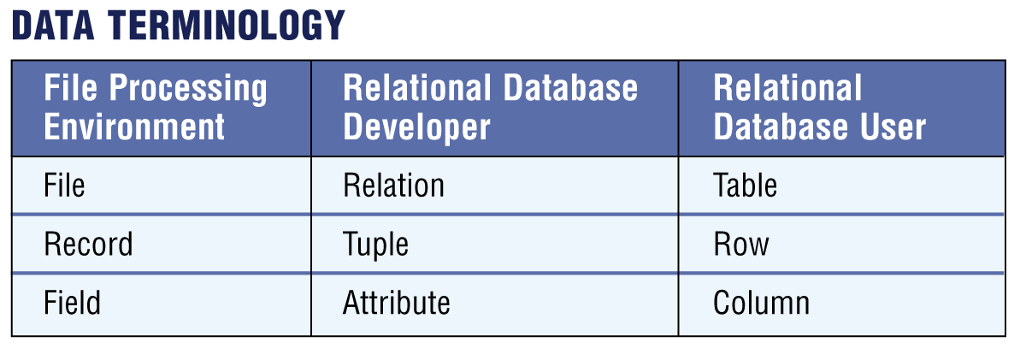
Relational, Object-Oriented, and Multidimensional Databases
What is a relational database?
  Stores data in tables that consist of rows and columns
    Each row has primary key
    Each column has unique name
  Stores data relationships
  Uses specialized terminology
Click to view Web
Link, click Chapter 10, Click
Web Link from left
navigation, then click
Relational Databases below Chapter 10
p. 533 Fig. 10-19
Next

Slide 33
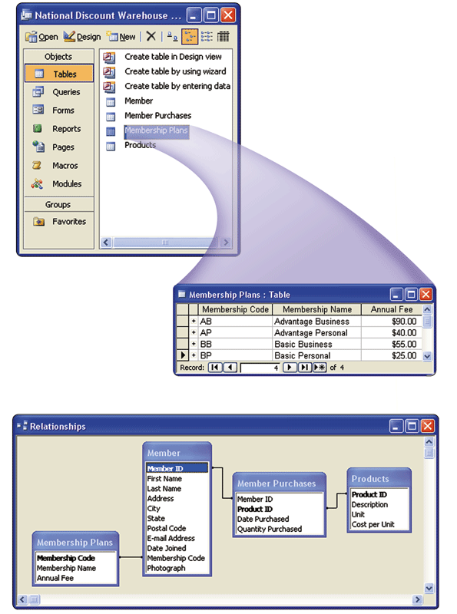
Relational, Object-Oriented, and Multidimensional Databases
What is a relationship?
  Connection within data
p. 533 Fig. 10-20
Next

Slide 34
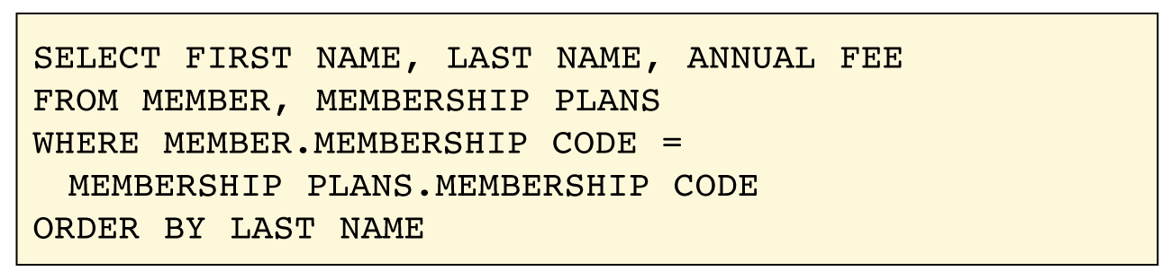
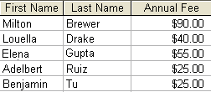
Relational, Object-Oriented, and Multidimensional Databases
What is Structured Query Language (SQL)?
  Allows you to manage, update, and retrieve data
  Has special keywords and rules included in SQL statements
SQL statement
SQL statement results
Click to view Web
Link, click Chapter 10, Click
Web Link from left
navigation, then click
SQL below Chapter 10
p. 534 Fig. 10-21
Next

Slide 35
Relational, Object-Oriented, and Multidimensional Databases
What is an object-oriented database (OODB)?
Object is item that contains data, as well as actions that read or process data
Stores data in objects
  Can store more types of data
  Can access data faster
Advantages
Often uses object query language (OQL)
Click to view Web
Link, click Chapter 10, Click
Web Link from left
navigation, then click
Object-Oriented Databases below Chapter 10
p. 534
Next

Slide 36
Relational, Object-Oriented, and Multidimensional Databases
What are examples of applications appropriate for an
object-oriented database?
Multimedia databases
Groupware databases
Store images, audio clips,
and/or video clips
Store documents such as schedules, calendars, manuals, memos, and reports
Computer-aided design
(CAD) databases
Hypertext databases
Store data about
engineering, architectural,
and scientific designs
Contain text links
to other documents
Hypermedia databases
Web databases
Contain text, graphics,
video, and sound
Link to e-form on Web page
p. 534
Next

Slide 37
Relational, Object-Oriented, and Multidimensional Databases
What is a multidimensional database?
Stores data in dimensions
Multiple dimensions, also called hypercube, allow users to analyze any view of data
Can consolidate data much faster than relational database
Click to view Web
Link, click Chapter 10, Click
Web Link from left
navigation, then click
Multidimensional Databases below Chapter 10
p. 535
Next

Slide 38
Relational, Object-Oriented, and Multidimensional Databases
What is a data warehouse?
    Huge database system that stores and manages data required to analyze historical and current transactions
    Quick and efficient way to access large amounts of data
    Often uses a process called data mining to find patterns and relationships among data
    Uses multidimensional databases
    Data mart is smaller version of data warehouse
p. 536
Next

Slide 39
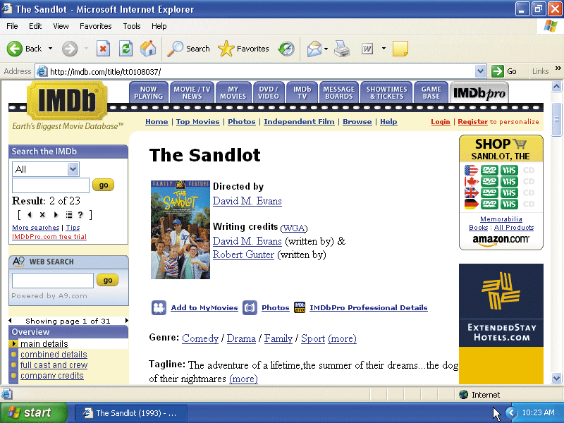
Web Databases
What is a Web database?
  Database you access through the Web by filling in a form on a Web page
  Usually resides on a database server, a computer that stores and provides access to a database
Click to view Web
Link, click Chapter 10, Click
Web Link from left
navigation, then click
Web Databases
below Chapter 10
p. 536 - 537 Fig. 10-23
Next

Slide 40
Database Administration
What are guidelines for developing a database?
1. Determine the purpose of the database
2. Design the tables
3. Design the records and fields for each table
  Design tables on paper first
  Each table should contain
  data about one subject
  Be sure every record has a unique
  primary key
  Use separate fields for logically
  distinct items
  Do not create fields for information
  that can be derived from entries in
  other fields
  Allow enough space for each field
  Set default values for frequently
  entered data
4. Determine the relationships among
the tables
p. 537 Fig. 10-24
Next

Slide 41
Database Administration
What is the role of the database analyst and administrator?
Database analyst (DA)
Database administrator (DBA)
Focuses on meaning and usage of data
Decides proper placement of fields, defines relationships, and identifies users’ access privileges
Creates and maintains data dictionary, manages
database security,
monitors database performance, and checks backup and recovery procedures
Click to view Web
Link, click Chapter 10, Click
Web Link from left
navigation, then click
Database Administrators below Chapter 10
p. 538
Next

Slide 42
Summary of Database Management
How data and information are
valuable assets to an organization
Advantages of organizing
data in a database
Methods for maintaining
high-quality data
Various types of databases
Assessing the quality of
valuable information
Role of the database
analysts and administrators
Chapter 10 Complete

